Slide 1
Set Theory Rules of Inclusion : Example
www.Stats-Lab.com
Twitter: @StatsLabDublin

Slide 2
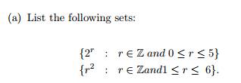
Rules of Inclusion

Slide 3
Rules of Inclusion

Slide 4
Set Theory Venn Diagrams
www.Stats-Lab.com
Twitter: @StatsLabDublin

Slide 5
Venn Diagrams
Suppose we have a labelled Venn diagram depicting A, B, C in such a way that they divide the universal set U into 8 disjoint regions.
The subset Y ⊆ U is deﬁned as Y = A ∪ (C − B).
Sketch the region Y on the Venn Diagram (shade in the appropriate regions).
Construct a membership table for Y.

Slide 6
Venn Diagrams
Y = A ∪ (C − B).

Slide 7
Venn Diagrams
A | B | C | Y
0 | 0 | 0
0 | 0 | 1
0 | 1 | 0
0 | 1 | 1
1 | 0 | 0
1 | 0 | 1
1 | 1 | 0
1 | 1 | 1

Slide 8
Venn Diagrams
A | B | C | Y
0 | 0 | 0 | 0
0 | 0 | 1 | 1
0 | 1 | 0 | 0
0 | 1 | 1 | 0
1 | 0 | 0 | 1
1 | 0 | 1 | 1
1 | 1 | 0 | 1
1 | 1 | 1 | 1

Slide 9
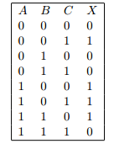
Venn Diagrams
Suppose we have a labelled Venn diagram depicting A, B, C in such a way that they divide the universal set U into 8 disjoint regions.
The subset X ⊆ U is deﬁned by the following membership table:

Slide 10
Venn Diagrams
Shade the region X on your diagram.

